Slide 1
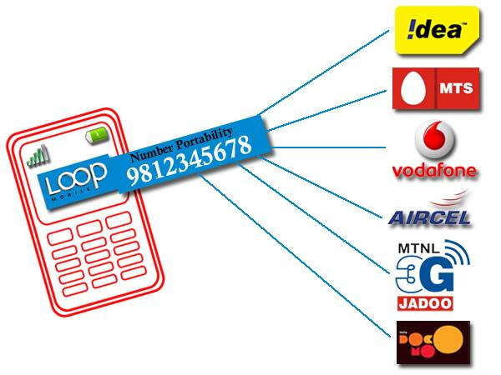
Remember this ?

Slide 2


Bringing the
Clouds Together

Slide 3
Bringing the
Clouds Together
CLOUD SERVICES
THE FUTURE OF

Slide 4


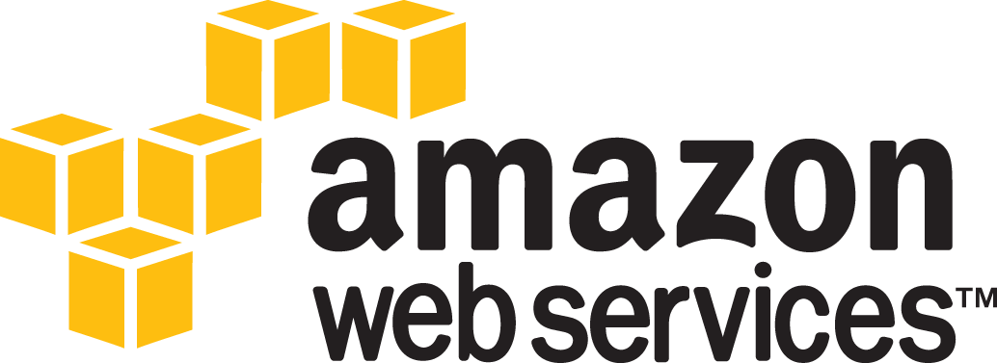
VIVEK JUNEJA
CLOUD GUY
COFOUNDER
USER GROUP BANGALORE
developer / evangelist / blogger

Slide 5

#bcb12
@vivekjuneja

Slide 6
~ agenda ~
+ not that long ago
+ the rise of the *.*
+ the 6 commandments

Slide 7
~ agenda ~
+ not that long ago
+ the rise of the *.*
+ the 6 commandments

Slide 8

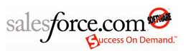


+ not that long ago
…’02...’04....’06...

Slide 9



+ not that long ago
...’06...’07....’08...

Slide 10

the problem with
few

Slide 11

+ the problem with few
Fear of lock-in

Slide 12

+ the problem with few
Lack of choice

Slide 13

+ the problem with few
One choice does not fit All

Slide 14

+ the problem with few
Lack of standards

Slide 15

+ the problem with few
Lack of maturity in cloud implementation

Slide 16
~ agenda ~
+ not that long ago
+ the rise of the *.*
+ the 6 commandments

Slide 17
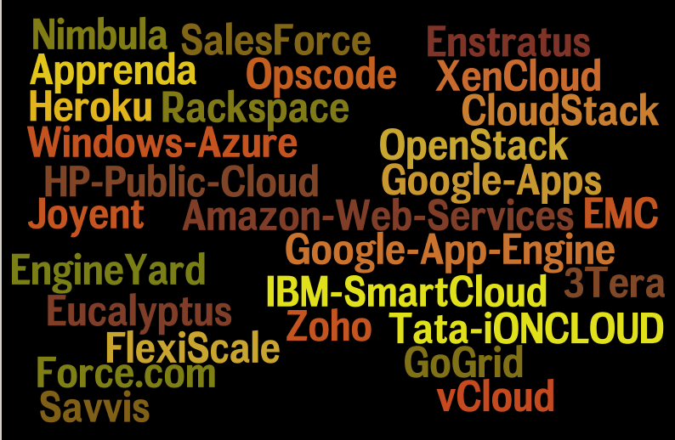
+ the rise of *.*

Slide 18
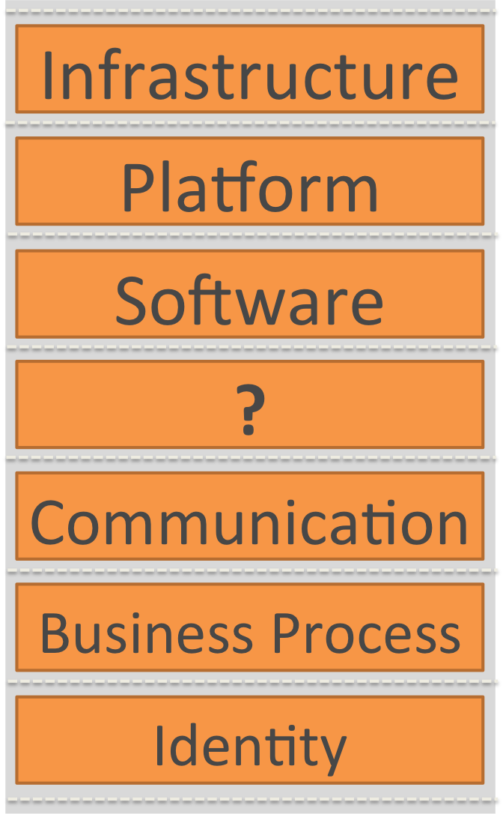
+ the rise of *.*
as a Service

Slide 19

why do you need
*.*

Slide 20

+ why do you need *.*
Outages and Downtime

Slide 21



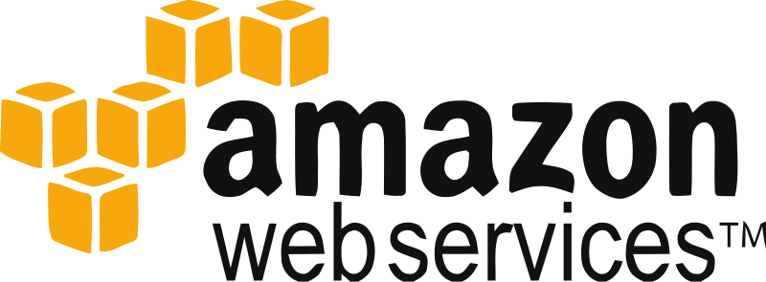
+ why do you need *.*
Need to look beyond AWS as default

Slide 22

+ why do you need *.*
Cloud provider nearest to the consumer

Slide 23

+ why do you need *.*
Boost Fault tolerance and High Availability

Slide 24

+ why do you need *.*
Right Cloud for the right Job

Slide 25

+ why do you need *.*
Insulate against pricing changes

Slide 26

the problem with
*.*

Slide 27

+ the problem with *.*
Redundant Data across multiple providers

Slide 28

+ the problem with *.*
Integration is point to point

Slide 29

+ the problem with *.*
Lack of standards in cloud interoperability

Slide 30

+ the problem with *.*
When to use what syndrome

Slide 31

+ the problem with *.*
How to insulate locking in with a provider

Slide 32
~ agenda ~
+ not that long ago
+ the rise of the *.*
+ the 6 commandments

Slide 33
Before we
start.....

Slide 34

XYZ Systems
App Front End
Caching
IAM / ADS
Business Objects
Legacy 1
Legacy 2
Database / FS
Local Data Center

Slide 35
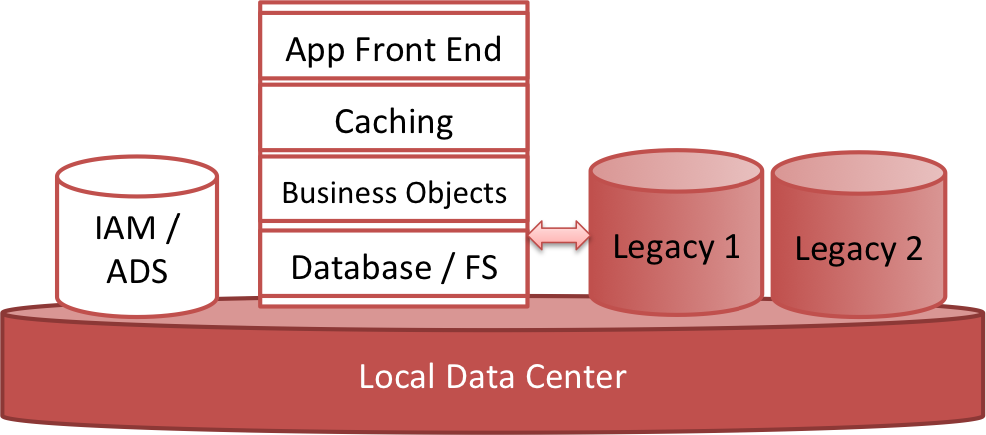
XYZ Systems
Periodic spikes in Usage

Slide 36
XYZ Systems
Internal infrastructure insufficient

Slide 37
XYZ Systems
Infrastructure for periodic spikes not feasible

Slide 38
XYZ Systems
Legacy infrastructure cannot be outsourced

Slide 39
XYZ Systems
Need to use local IAM

Slide 40
1
+ commandment
Integration as a
Service

Slide 41


Integration as a Service

Slide 42
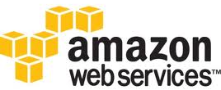
2
+ commandment
Workload Import
& Export
VM Import / Export

Slide 43
2
+ commandment
Use of Platform
agnostic
P A A S

Slide 44




Use of Platform agnostic PAAS
appscale

Slide 45
3
+ commandment
Automate
Deployment and
Configuration

Slide 46

Automate Deployment and Configuration

Slide 47
4
+ commandment
Standardize
Sizing
Small Instance (Default)
1.7 GB of memory
1 EC2 Compute Unit (1 virtual core with 1 EC2 Compute Unit)
160 GB of local instance storage
32-bit or 64-bit platform

Slide 48
4
+ commandment
Standardize
Sizing

Slide 49
4
+ commandment
Standardize
Sizing

Slide 50

5
+ commandment
API unification
client = DeltaCloud.new( api_name, api_password, api_url )
# switch the client to use EC2 driver
ec2 = client.with_config(:driver => :ec2)
# switch the client to use OpenStack driver
openstack = client.with_config(:driver => :openstack)

Slide 51

5
+ commandment
API unification
// Amazon EC2
java -jar target/compute-basics-jar-with-dependencies.jar aws-ec2 accesskey secretkey mygroup add
// HP Public Cloud
java -jar target/compute-basics-jar-with-dependencies.jar hpcloud-compute tenantId:accesskey secretkey mygroup add

Slide 52
6
+ commandment
Think Global, Act Local

Slide 53

Think Global, Act Local

Slide 54

Think Global, Act Local

